Slide 1
Testbytes Corporate
Presentation

Slide 2
v
Quality Matters the most when it comes to software products.
An expert QA company must be able to Verify and validate it.
That’s the situation where we, Testbytes can be at your service.

Slide 3
v
Testbytes has been in the QA industry since 2011.
From the very start itself, we have managed to deliver the best and be the QA option for many companies across the globe.

Slide 4
Testbytes can check-recheck and validate performance, functionality security, and usability of your software (web-mobile-desktop) with exemplary efficiency.

Slide 5
What Makes us Capable?
Highly skilled testers
State-of-the-art Facility
Custom environment for varied software
Detailed report generation
Maximum test coverage
Detailed test case design and flawless execution
Real device /emulator/simulator at disposal for testing
Ethical hackers/ security analysts to fish out security loopholes
Full-fledged team and resource for security audit

Slide 6
Our Trusted Methodology
Sprint planning /Refine Acceptance
Automation Tests Maintenance
Requirements Analysis + Kickoff
1
9
2
Demo
Test Scenarios Creation
8
3
SPRINT
7
4
Pre-Production Release Testing
Automation Tests Implementation
6
5
Automation Tests Execution
Story Testing (Manual + Exploratory)

Slide 7
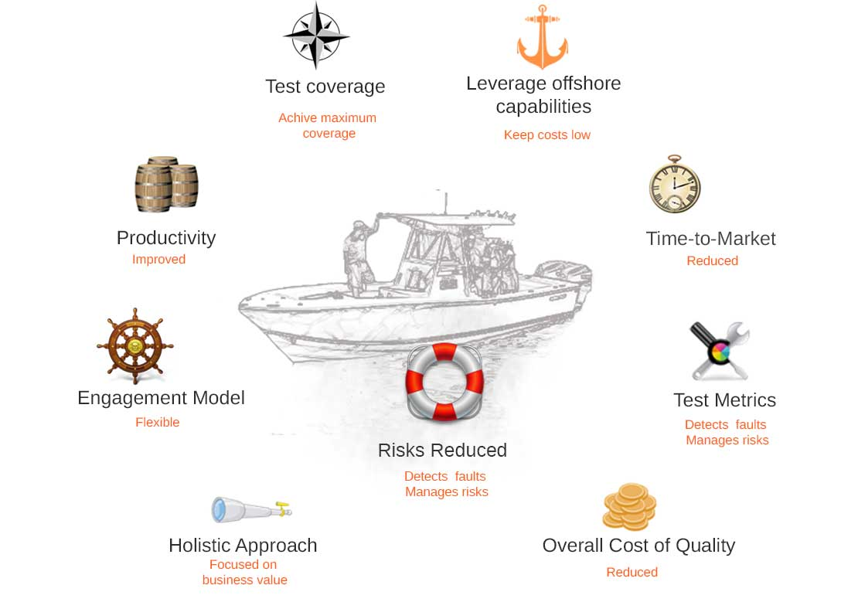
What can you expect?

Slide 8
Our Engagement Models
Long Term Partnership
Outsourcing testing as service
On Demand Staffing and Hiring
We can be your integral QA association for a prescribed time
Dire need of a QA partner for a particular project? We can be the perfect solution
Wish to hire talented testers on a contract basis? We have what you are looking for

Slide 9
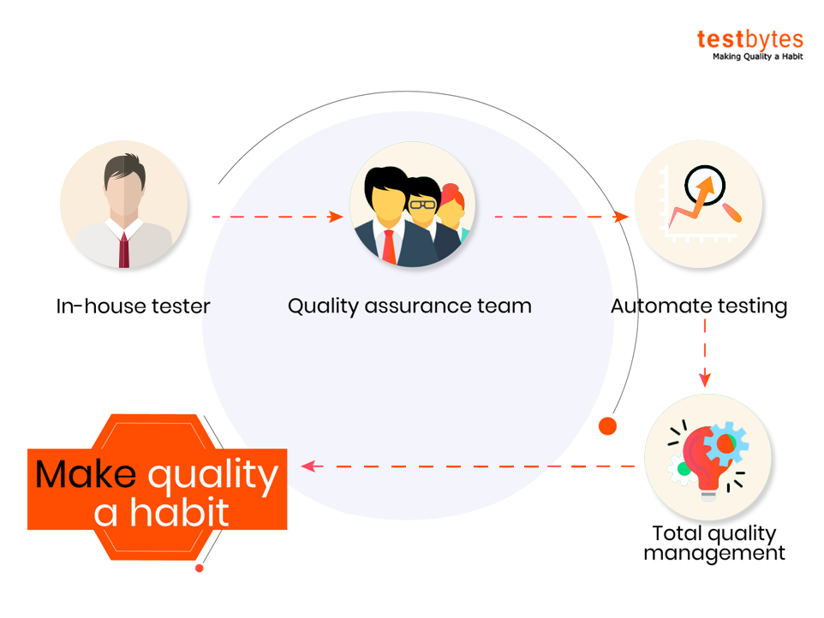
How We Facilitate QA Evolution
as a Quality Partner?

Slide 10
Long-term Partnership Advantage
Testbytes can be the pillion for quality implementation and governance in your organization
You will get an excellent QA partner to achieve business objective and customer satisfaction
We ensure that quality is maintained as a habit in your organization
We Firmly believe that quality is not something that should be restricted to a particular project or something that’s based on consultation. We make sure that it’s practiced boundlessly

Slide 11
Outsourcing Testing as a Service
Performance testing
Security Testing
Mobile application testing
Test Automation
Web application testing
Game Testing

Slide 12
Benefits of Outsourcing
Testing As a Service
Flexible test execution
Cost-effective
Secure data management
Cloud resources and
shared accessibility
Earlier bottleneck detection and removal
Constant monitoring facilities
Holistic approach
Scalable and flexible delivery model

Slide 13
On Demand Staffing and Hiring
ENGAGEMENT TYPE
ON DEMAND
PART TIME
DEDICATED
Duration
Hourly
4 Hours/day
8 Hours/day
Hiring Period(min)
40 Hours
80 Hours
160 Hours
Communication
Zoom, Slack, Skype, Email
Project Trackers
Trello, Confluence, Daily Reports, Basecamp, Jira, Redmine, etc.

Slide 14
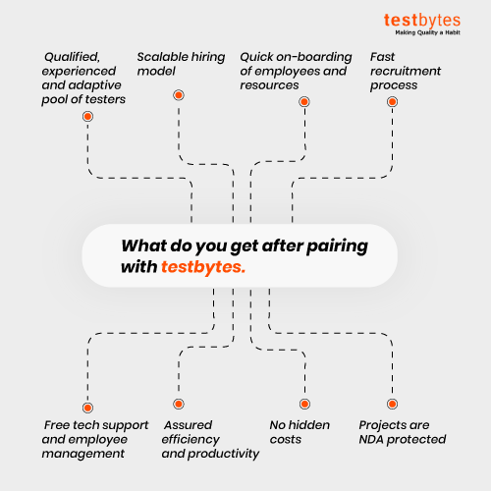

Slide 15
Our Team
Project Manager
QA Lead
Test Lead
Usability Tester
Manual Tester
Automation Tester
Red Hat Team (Security Testing)
Tester
Tester
Tester
Tester
Tester
Tester
Tester
Tester

Slide 16
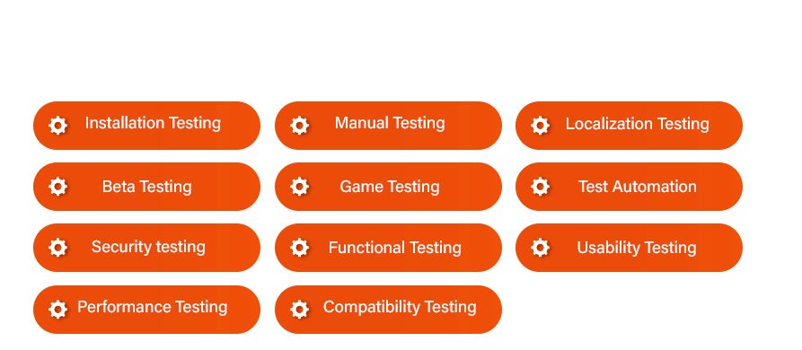
Types of testing we are capable of

Slide 17
We nurture a global community!
Our Website as well as social media handles have manged to garner huge viewership. For instance, Our Linkedin company account has more than 35,000+ followers and it’s climbing as you read this.
Join US!

Slide 18
Our Knowledge Center
We have more than 500+ blogs in our website! Each blogs has been uploaded and categorised after stringent and scrutinous evaluation.
We are indebted to share knolwdge as we firmly belive that it will help in maintaining quality as a habit.
Click here!

Slide 19
Our SMEs are the best!
Do not have proper document? Our SMEs can handle this with ease!
SMEs make sure that your project never hits a road-block.
SMEs service is an option and you can avail their assistance either hourly or daily basis.

Slide 20
Clients
And Many More….

Slide 21
Queries? Please ask away
Kalas road, Vishrantwadi, Pune, Maharashtra-411015
info@testbytes.net
+91 811 386 5000
65 Broadway Suite 1101, New York NY 10006
info@testbytes.net
+1 (212) 744-1256
info@testbytes.net

